Slide 1


New Discoveries through the Work of the CFPB on Mortgages and Dynamic Data Analysis Project Plan
Sayaka Berkley
Oct 23 2024
Data 205- 22017

Slide 2

The Data
Dynamic National Loan-Level Dataset
HMDA – Home Mortgage Disclosure Act
2018-2022

Slide 3

Research goals
“To contribute to the improvement of CFPB's mortgage-related regulations and the soundness of the mortgage market”
Questions
In-depth analysis of specific frauds
Analysis of specific regions or attributes
Systemic failures

Slide 4
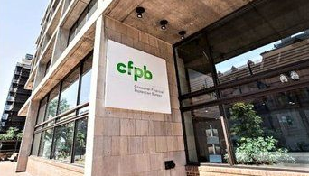

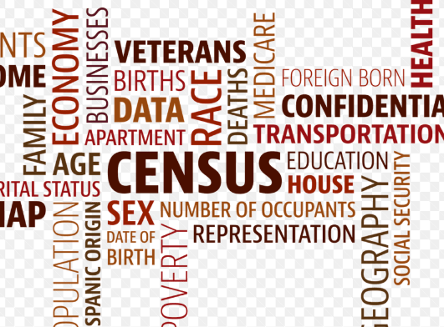
Tools, methods, and resources

Slide 5


Risks and mitigations
Multivariate relationships
External factors
Privacy violations

Slide 6

Milestones
Oct 2024
November 2024
December 2024
Clarification of goals
Building models/ visualizations
Assumption of hypothesis
Model construction/ Model evaluation
Creating a slide for dry Runs
10/23 submission
11/6 Submission
12/18 Submit final report
<Important Date>
11/13 Progress report submission
12/4 Project Drafts Due
12/11 Submit final cleaned up GitHub repo etc.

Slide 7
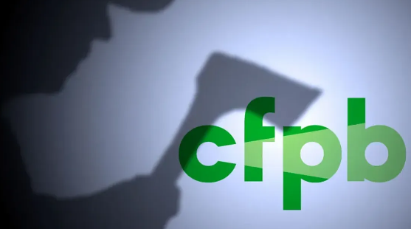


THANK YOU!
Sayaka Berkley
sberkley@motgomerycollege.edu

